Slide 1
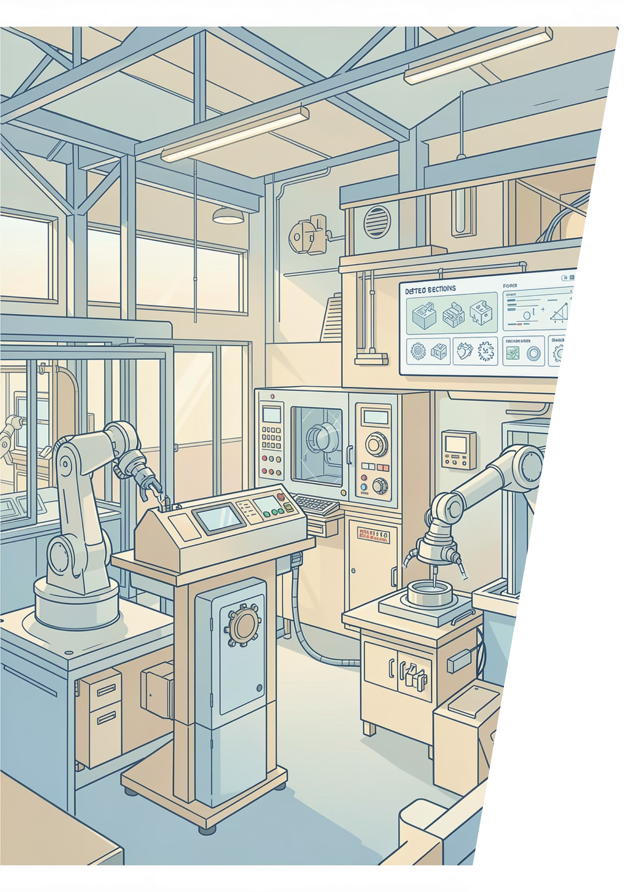
SurfaceVision AI
Multi-Domain Surface Defect Inspection System
HACKATHON 2026

Slide 2

Current Challenges
Metal Manufacturing
Building Safety
Surface defects cost billions in rework and scrap
Structural damage goes undetected until it's too late

Slide 3
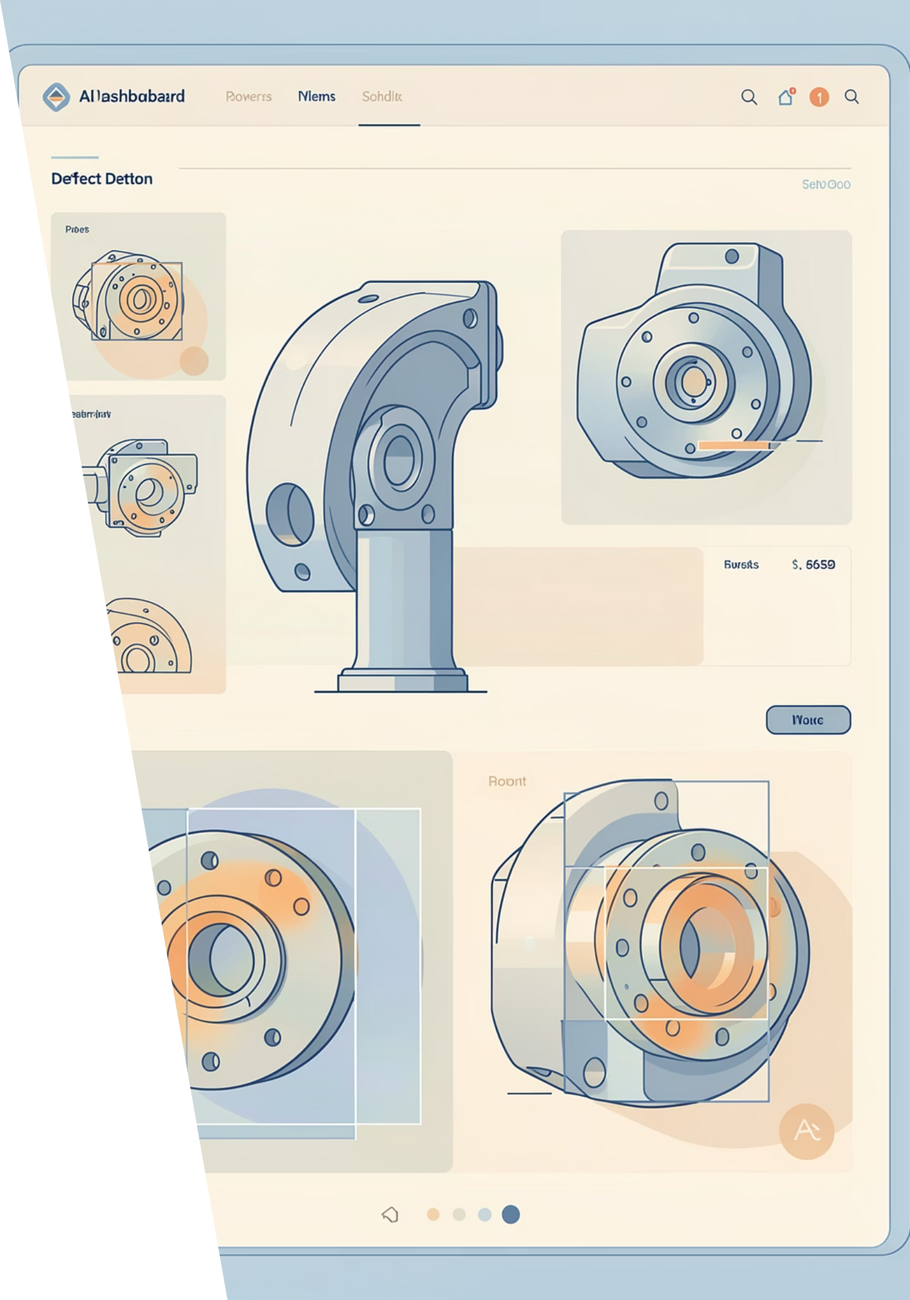
SurfaceVision AI Solution
An AI system that uses supervised detection to identify known defect types, providing precise quality assurance for familiar issues.
Phase 1: Supervised
YOLOv8 identifies known defect types with precision bounding boxes
Phase 2: Anomaly
PatchCore flags unexpected abnormalities with visual heatmaps

Slide 4
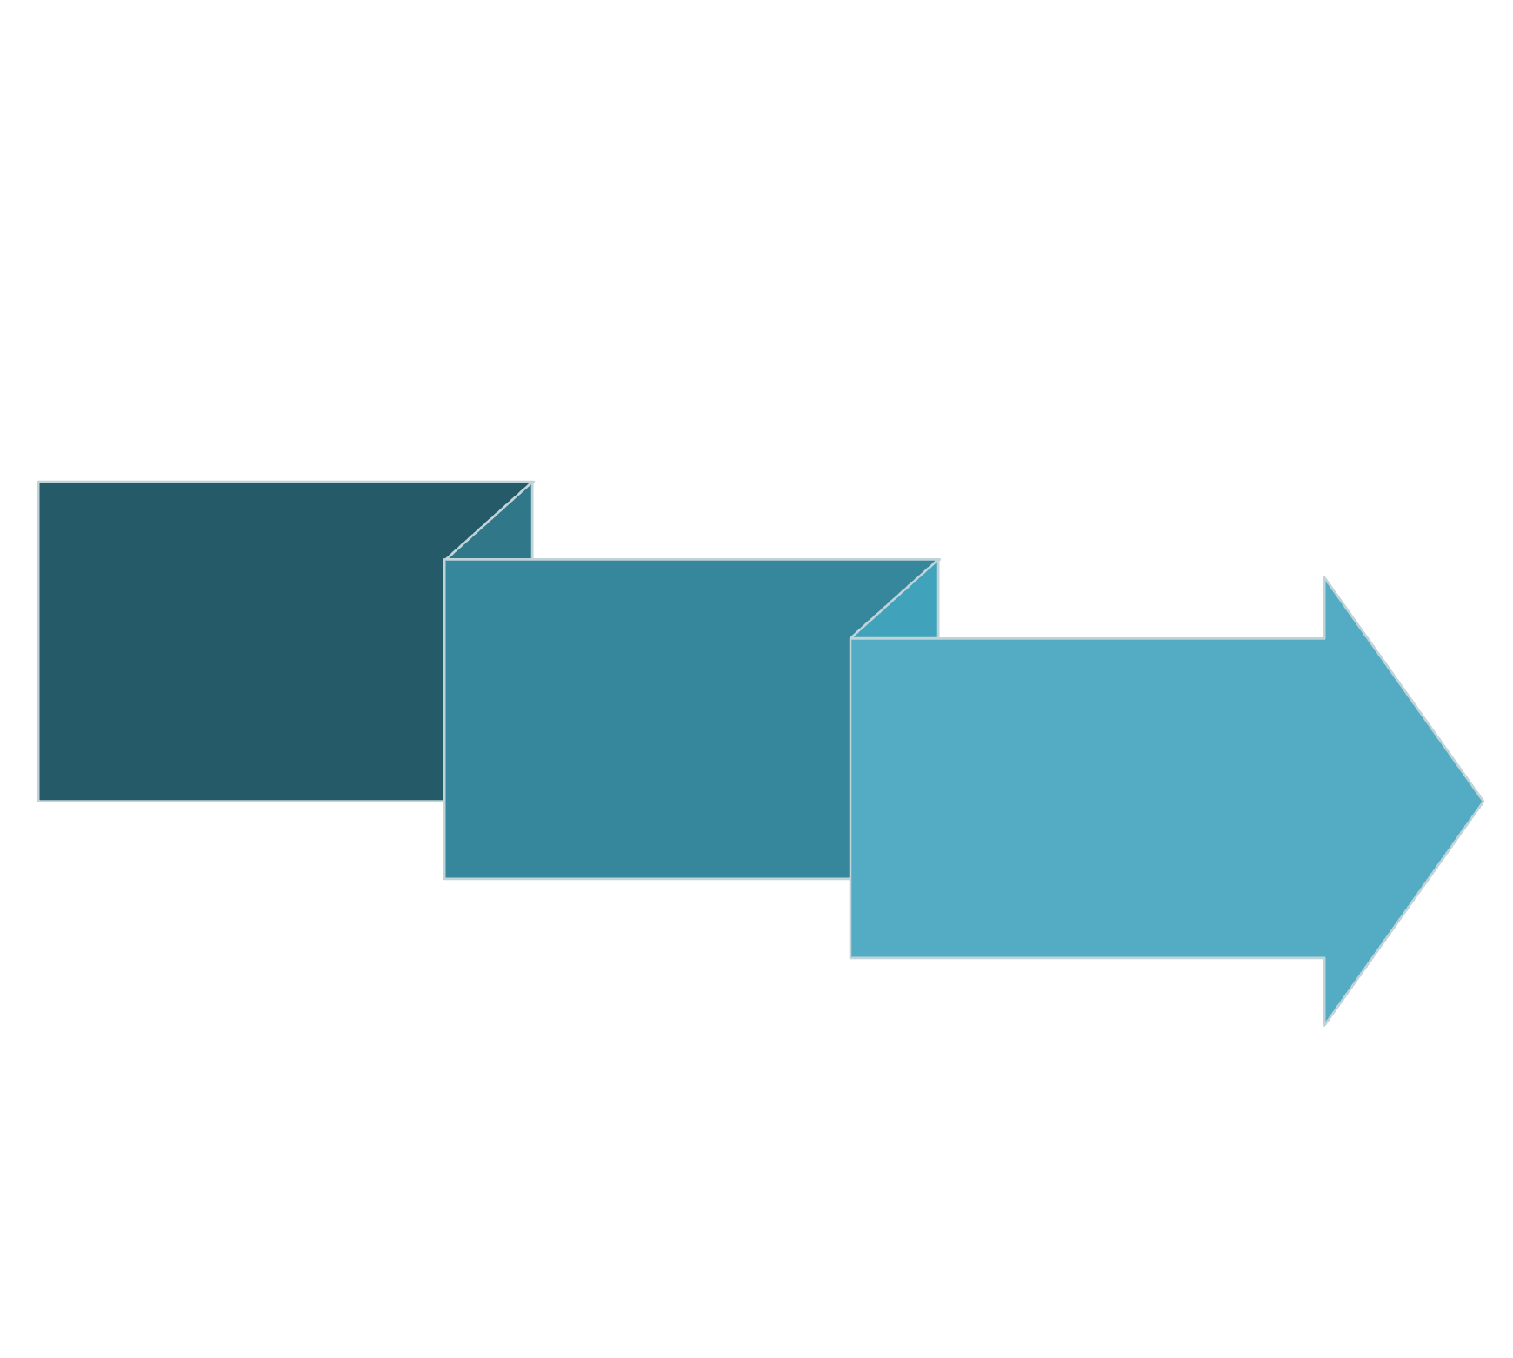
Surface Defect Detection Architecture
Input Image
Output with Bounding Boxes and Confidence Scores
YOLOv8 Detection
This architecture uses YOLOv8 to identify known defect patterns, providing precise detection with bounding boxes and confidence scores for each identified defect.

Slide 5
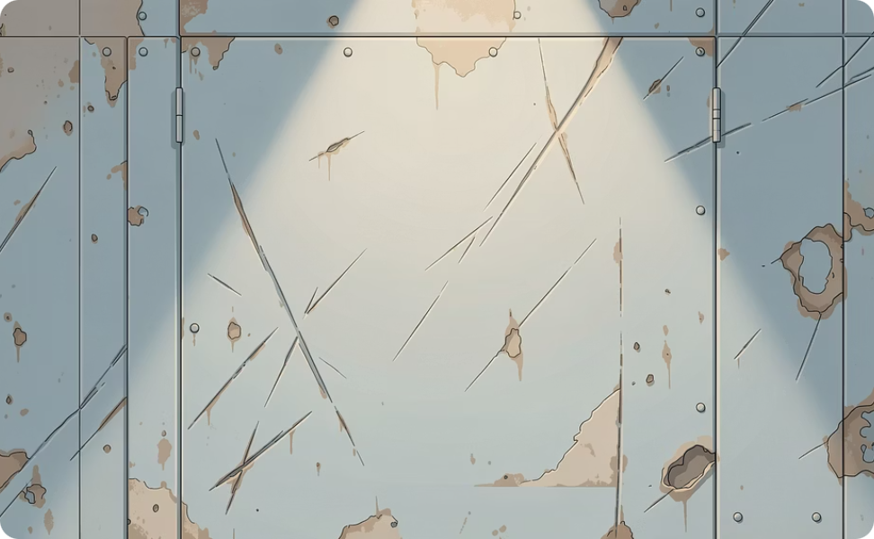
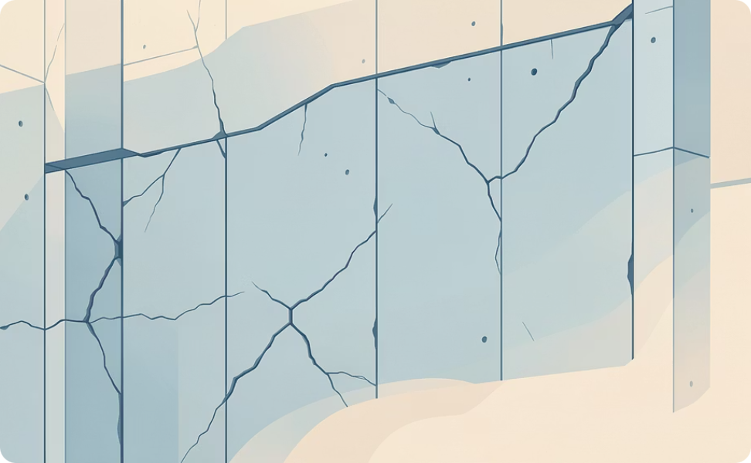
Multi-Domain Coverage
Metal Manufacturing
Building Inspection
Detects scratches, pits, inclusions, patches, rolled-in scale, and crazing on steel surfaces using NEU-DET dataset.
Flags concrete cracks, spalling, corrosion, and structural damage for preventive maintenance and safety compliance.

Slide 6




Use Cases & Applications
Automotive Manufacturing
Aerospace and Ship Building Quality Control
Inspects critical components like engine blocks, chassis, and body panels for weld defects, surface imperfections, and structural anomalies, ensuring vehicle safety and performance.
Identifies microscopic cracks, fatigue, and material inconsistencies in aircraft parts such as turbine blades, wing structures, and fuselage components, crucial for flight safety.
Furnishings Manufacturing
Infrastructure Inspection
Inspects wooden surfaces, joints, and upholstery for defects like cracks, splinters, uneven finishes, misaligned edges, and fabric tears — ensuring product quality and aesthetic consistency before delivery.
Detects cracks, potholes, corrosion, and structural integrity issues on bridges, roads, and railway tracks, preventing failures and extending asset lifespan.

Slide 7
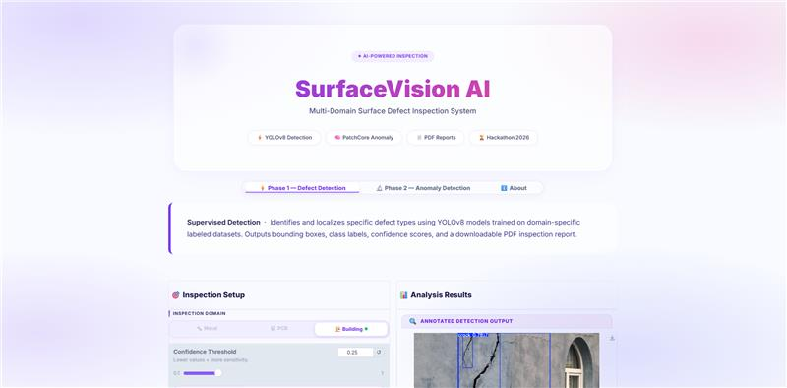


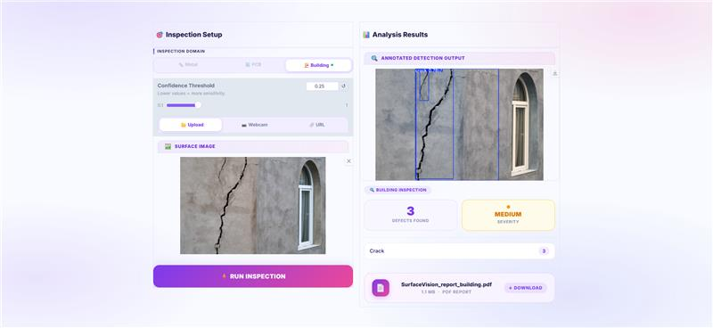


System Demonstration
01. Upload image or use webcam for live inspection
02. Select domain: Metal or building
03. View detection results with bounding boxes and confidence scores
04. Download comprehensive PDF inspection report

Slide 8
Technical Foundation
Our system is built on a robust technical foundation, leveraging cutting-edge AI for defect detection, streamlined data processing, and seamless system integration.
Core Technologies
Training Datasets
Ultralytics YOLOv8: State-of-the-art object detection for known defects
Gradio: Rapid web interface development
OpenCV: High-performance image processing
FPDF2: Automated report generation
NEU-DET for metal surface defects
Kaggle structural damage collections
Google Colab notebooks enable reproducible training and rapid model iteration.

Slide 9
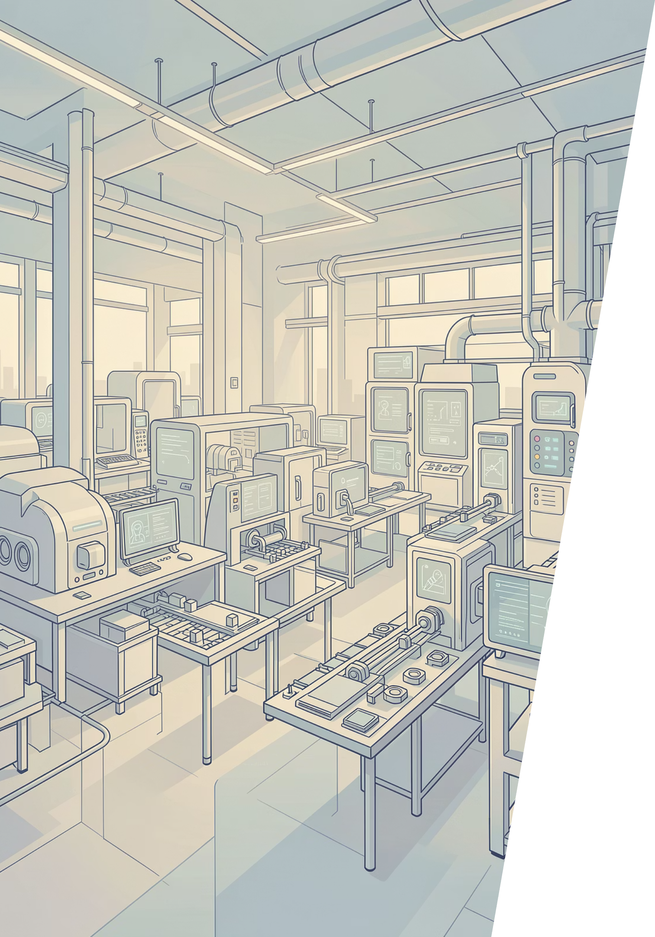



Scalability & Next Steps
Domain Expansion
Add textiles, pharmaceuticals, food processing sectors
Edge Deployment
Optimize models for real-time factory floor integration
Active Learning
Continuous improvement through production feedback loops
SurfaceVision AI is ready for pilot deployment and positioned to transform quality control across industries.

Slide 10

Thank You

